Slide 1

Wordpress Migration Project

Slide 2
Our team
Tran Hoai Nam
Nguyen Minh Trang
Nguyen Mai Huong

Slide 3
Agenda
Introduction
Our project
Real project
Practice
Conclusion

Slide 4
Introduction

Slide 5
About project
Project Name: Bonnier Migration
Mentors: Mr. Ngoc Tran and Mr. Tuan Ta
Members:
Nam Tran
Trang Nguyen
Huong Nguyen

Slide 6
Project Purpose
CMS Migration
The process of moving information or data which already stored on a Web content management system (CMS) to a new system.
Notes:
Migrating from

Slide 7
Project Purpose (cont.)
Migrate content from EpiServer to Wordpress
Upgrade old Wordpress version to the latest Wordpress core version
Ensure:
The CMS platform changed
Website remains functionally, work smoothly on new platform

Slide 8
Our project

Slide 9
Real Project
Wordpress
Definition
Wordpress themes
Wordpress actions and filters
Why do we need a child theme?
What we have done
Requirements
Resolved problem

Slide 10
Wordpress

Slide 11
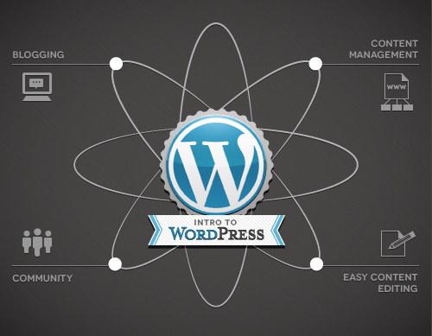
Wordpress
Notes:
Wordpress is a CMS (Content Management System)
Do the connection and interative with database. Everything is based on post type. You will interact with database by using Wordpress’s own function

Slide 12
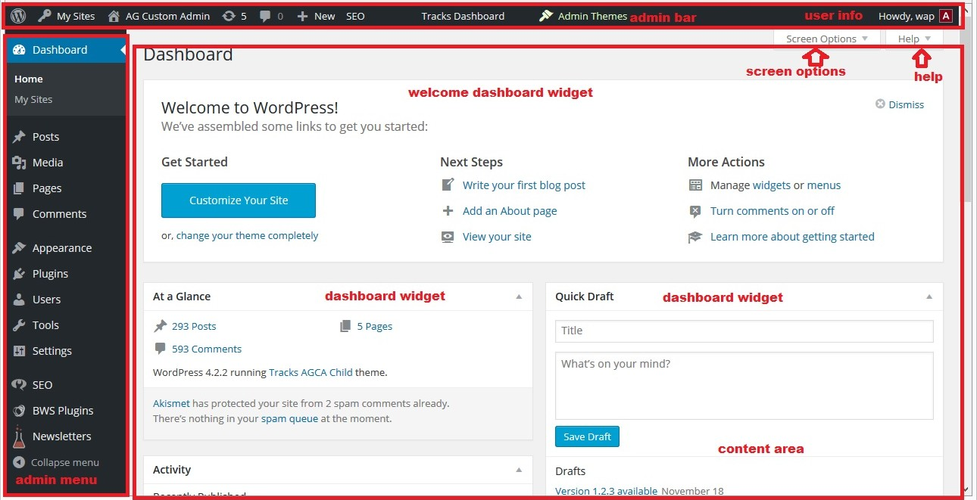

Slide 13
Wordpress theme
A WordPress theme changes the design of
your website, often including its layout
Themes take the content and data stored by
WordPress and display it in the browser

Slide 14
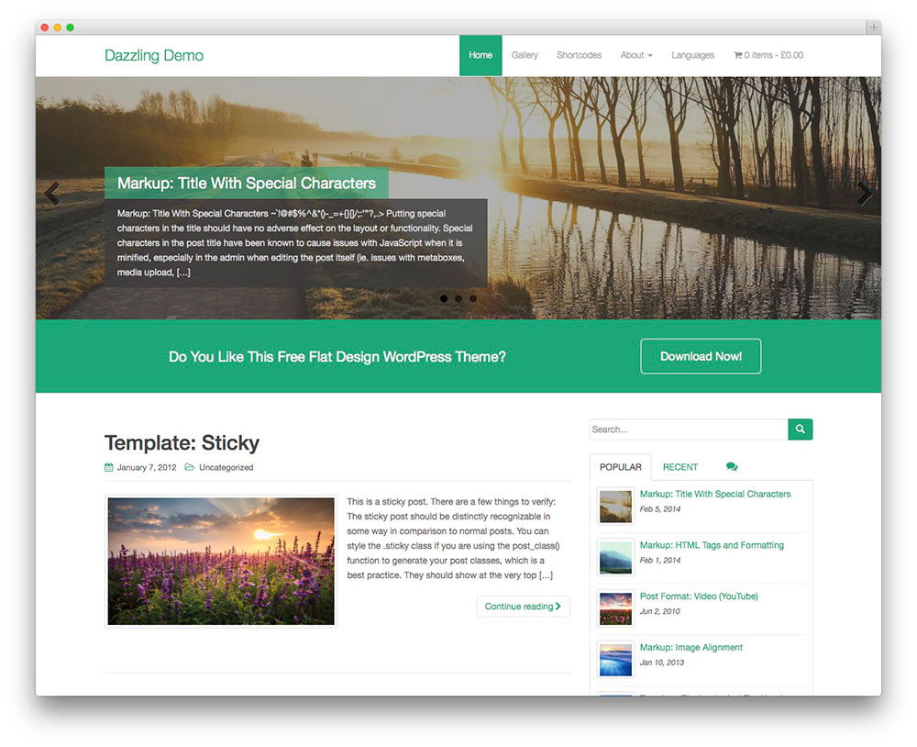

Slide 15
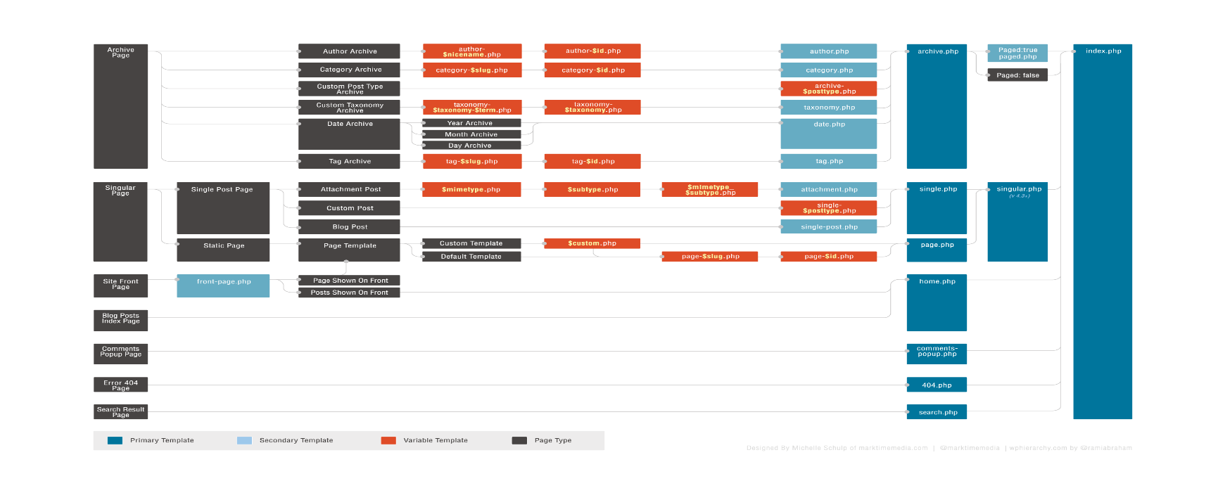
Wordpress hierarchy
Checkout here: https://wphierarchy.com/

Slide 16
Wordpress actions and filters
Wordpress hook
A “hook” is a certain location in the WordPress code which allows you to attach or run your own code
Another way of describing “hooks” is that they are sort of like designated areas within the WordPress code which give you the opportunity to execute your own functions.
Difference between actions and filters
The importance difference is filters will do something and return a value to change a default value but actions do not

Slide 17
Why we need a child theme
There are a few reasons why you would want to use a child theme:
If you modify a theme directly and it is updated, then your modifications may be lost. By using a child theme you will ensure that your modifications are preserved.
Using a child theme can speed up development time.
Using a child theme is a great way to learn about WordPress theme development.
Notes:
A child theme is a theme that inherits the functionality of another theme, called the parent theme. This then allows you to modify or add to the functionality of the parent theme in a safe manner.
The easiest explanation for why you should use a child theme is because it allows you to safely update the parent theme

Slide 18
What we have done

Slide 19
Requirements
Make a copy of damernasvarld-blog child theme and implement new theme
101 ideer’s blogs and M-magasin blogs should be based on the damernasvarld-blog child theme. The end result should be similar to the setup shown on this site: http://elin.damernasvarld.se/
Change some styles that mentioned in requirement documentation

Slide 20
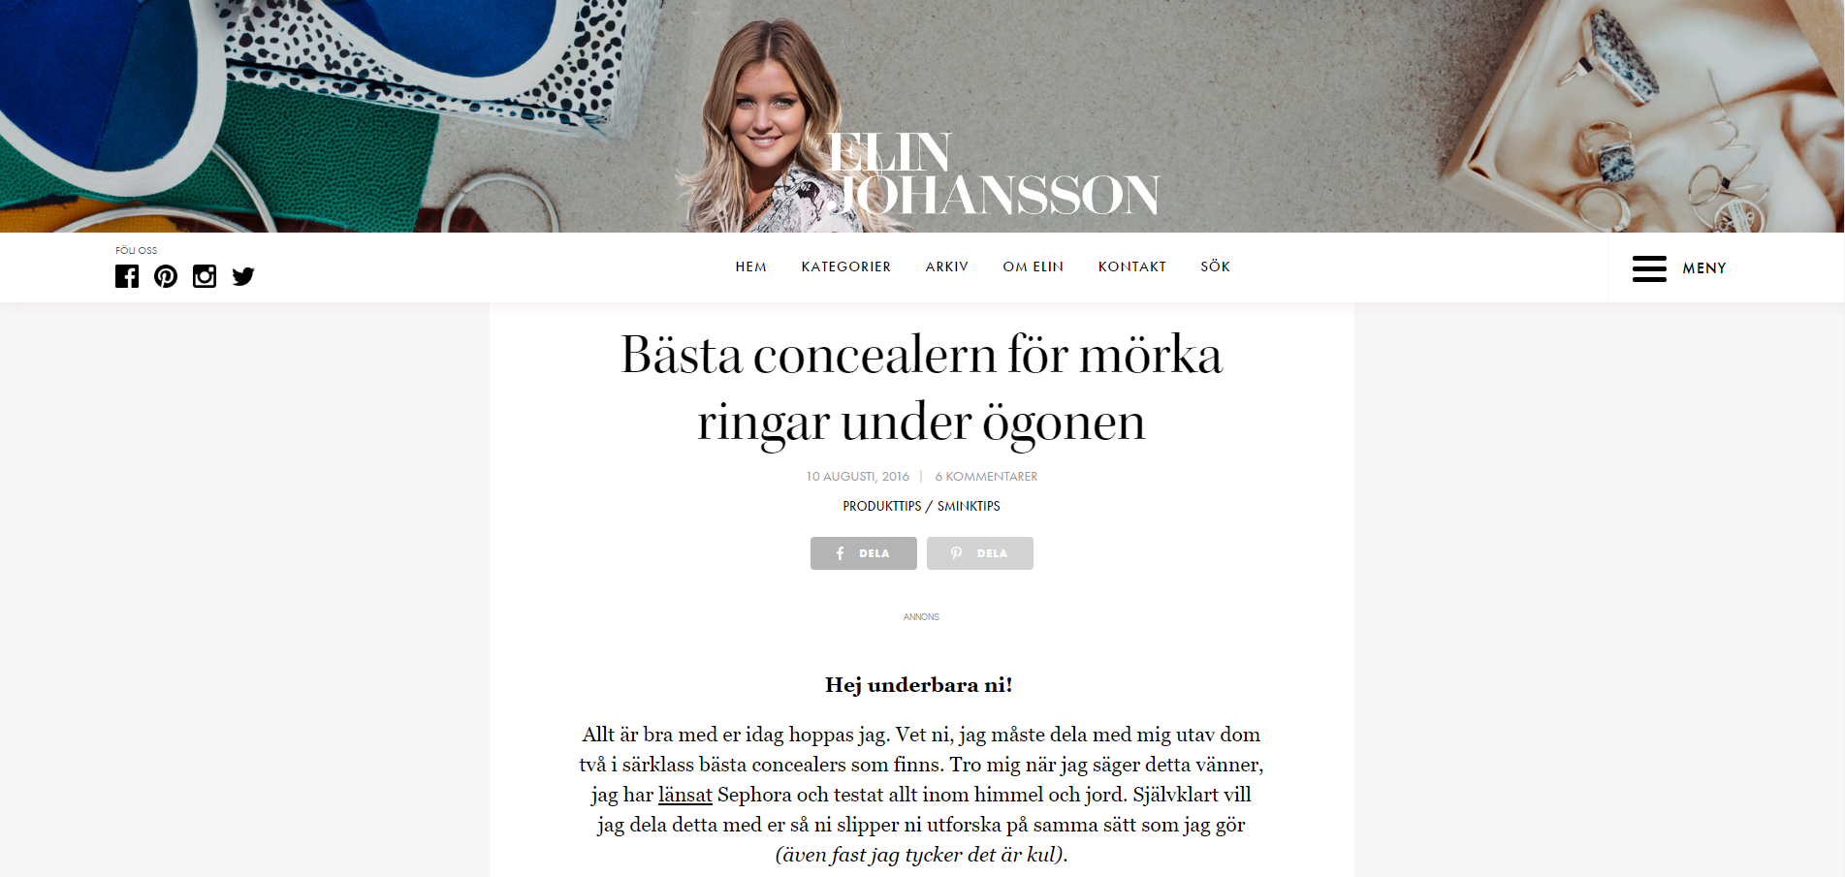

Slide 21
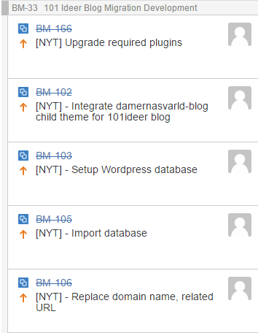
Assigned tasks
Setup Environment, database and configuration (create fake domain name in vhost file, replace that domain in database …)
Change styles based on requirements documentation and make the new theme that look similarly as the damernasvarld-blog
Verify the new theme and fix bugs
Deploy the project on local dev server and customer’s server

Slide 22
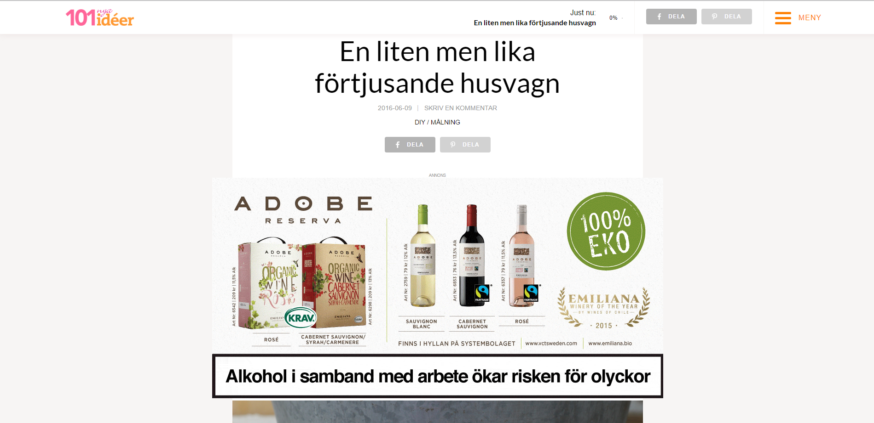
Demo websites

Slide 23
Practice: Alfuttaim – Home page
Requirements:
Build the Alfuttaim home page from its design (.psd file)
Use Handlebars, Sass and Grunt
Teamwork
Notes:
Besides the real project that we have done, Mr. Ngoc also gave us a mock project to practice and improve our knowledge about front end development. Here are the requirements.
The design is quite specific so all we need to do is to build the web page that looks as close to the design as possible.
We need to do this project in our free time because we still need to do the real project and the deadline was after 1 week.

Slide 24
Practice: Alfuttaim – Home page
Solutions:
Learn Handlebars and Sass
Divide the design into sections
Work independently
Use coding convention to avoid conflicts
Daily meetings
VCS: Git
Notes:
So we had the requirements in our hands. Right after that, we had a meeting to discuss about how we’re going to approach this problem.
First of all, before this project, all of us had no idea about Handlebars and Sass so we have to spend sometime to learn their basic syntax and functionality. It took us a day to do so. We used the top down approach to learn so we don’t need to learn everything, just what’s necessary to finish the project.
In order for us to work as a team as well as work independently, we decided to divide the design into 4 sections: …
We also used some coding convention like BEM to avoid conflicts in CSS.
We have no problem in communication because we sit next to each other and we are very open and supportive, especially Mr. Nam. It’s convenient for us to discuss and solve any issue that came up.
And lastly, we used Git as the version control system because it’s effective in managing the code and resolving conflicts. Our Git workflow is quite simple: Each of us created a branch and work independently, we only merge our code into master when a feature is completed and tested.

Slide 25
Practice: Alfuttaim – Home page
Results:
The Alfuttaim home page looks as designed
Skills:
Teamwork
Avoiding and resolving conflicts
Using new tools
Notes:
We’ve gained a lot of teamwork skill like how to handle the problem that was given as a team. As mentioned, we had daily meetings to discuss all the problems that we had and helped each other to solve them.
We’ve also learned some best practice and methods to avoiding and resolving conflicts and I think it’s very useful because having conflicts is a common issue when working in a team.
And thanks to this project, now we know the basic of Handlebars and Sass, we know how to use Grunt to compile our project.

Slide 26
Conclusion

Slide 27
Achievement
Basic HTML, CSS (Bootstrap), JavaScript (jQuery)
Wordpress Basic:
Theme development
Actions and filters
Grunt, Handlebars, Sass
Teamwork: Daily meeting, using Jira, Confluence, BitBucket, Git

Slide 28
Thanks for listening

Slide 29
Problem
Too large database -> take time to import
Use PHP Myadmin
Wordpress multisite

